Slide 1
Transformers and CNNs for semantic segmentation of cracks
Pooyan Ghodrati
Sujitha Ravichandran
Sravan Josh Koka
Rakesh Kumar Alasakani

Slide 2
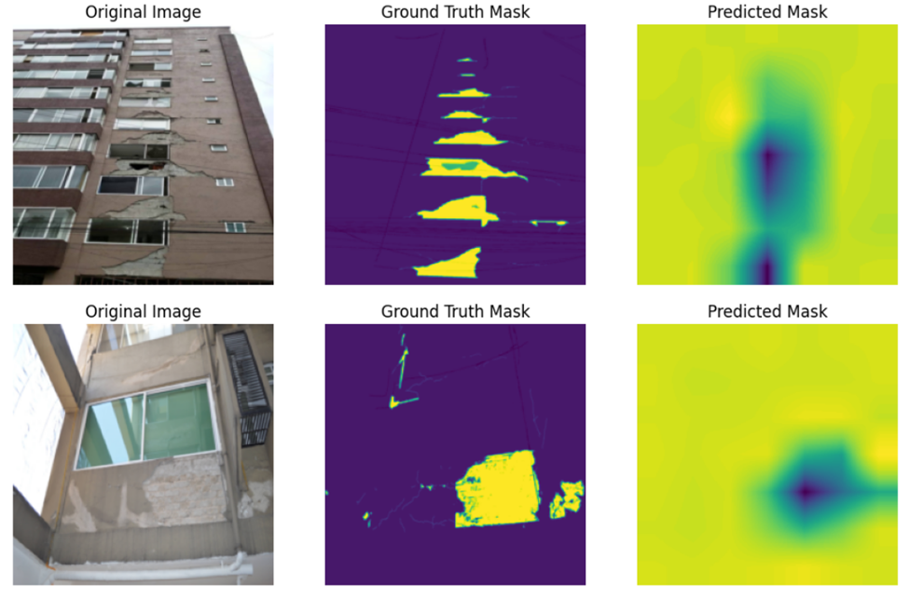
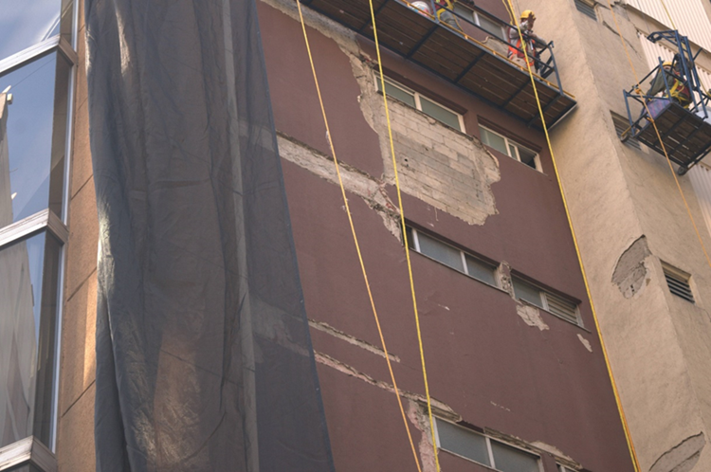
CNN model
Dataset:
ResNet18
1119 images
2 annotations – Fine Damage, Coarse Damage
Including vertical and horizontal images
1360 × 2048 pixels
Based model for semantic segmentation
One Conv2D added
Mixing both Fine and Coarse damages
Using 50 epochs
Image sizes reduced by 214 × 214 pixels
Coarse damage
Feature | Color
No | Black
Shadows | Grey
Dirt | Goldenrod
Vegetative Growth | Spring green
Debris | Fuchsia
Marks | Purple
Spelling | Tomato
Voids | Yellow
Fine damage
Feature | Color
No | Black
Scratches | Red
Grooves/Joints | Green
Cables | White
Filled Cracks | Light grey
Cracks | Red
Exposed Rebar | Orange

Slide 3


CNN model
Dataset:
ResNet18
1119 images
2 annotations – Fine Damage, Coarse Damage
Including vertical and horizontal images
1360 × 2048 pixels
Based model for semantic segmentation
One Conv2D added
Mixing both Fine and Coarse damages
Using 50 epochs
Image sizes reduced by 214 × 214 pixels
Coarse damage
Feature | Color
No | Black
Shadows | Grey
Dirt | Goldenrod
Vegetative Growth | Spring green
Debris | Fuchsia
Marks | Purple
Spelling | Tomato
Voids | Yellow
Fine damage
Feature | Color
No | Black
Scratches | Red
Grooves/Joints | Green
Cables | White
Filled Cracks | Light grey
Cracks | Red
Exposed Rebar | Orange

Slide 4
CNN model
Dataset:
ResNet18
1119 images
2 annotations – Fine Damage, Coarse Damage
Including vertical and horizontal images
1360 × 2048 pixels
Based model for semantic segmentation
One Conv2D added
Mixing both Fine and Coarse damages
Using 50 epochs
Image sizes reduced by 214 × 214 pixels
Coarse damage
Feature | Color
No | Black
Shadows | Grey
Dirt | Goldenrod
Vegetative Growth | Spring green
Debris | Fuchsia
Marks | Purple
Spelling | Tomato
Voids | Yellow
Fine damage
Feature | Color
No | Black
Scratches | Red
Grooves/Joints | Green
Cables | White
Filled Cracks | Light grey
Cracks | Red
Exposed Rebar | Orange

Slide 5
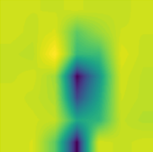
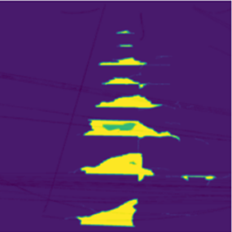
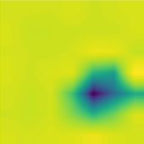
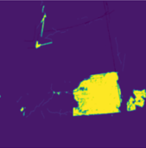
CNN model
Dataset:
ResNet18
1119 images
2 annotations – Fine Damage, Coarse Damage
Including vertical and horizontal images
1360 × 2048 pixels
Based model for semantic segmentation
One Conv2D added
Mixing both Fine and Coarse damages
Using 50 epochs
Image sizes reduced by 214 × 214 pixels
Coarse damage
Feature | Color
No | Black
Shadows | Grey
Dirt | Goldenrod
Vegetative Growth | Spring green
Debris | Fuchsia
Marks | Purple
Spelling | Tomato
Voids | Yellow
Fine damage
Feature | Color
No | Black
Scratches | Red
Grooves/Joints | Green
Cables | White
Filled Cracks | Light grey
Cracks | Red
Exposed Rebar | Orange

Slide 6
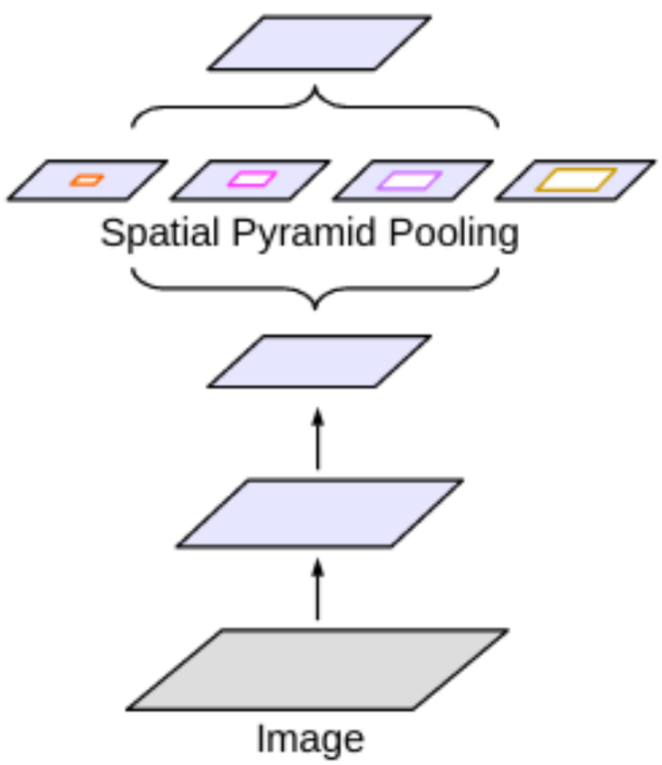
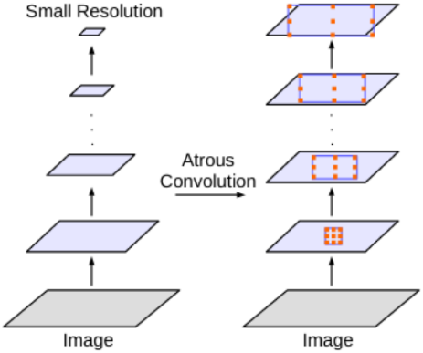
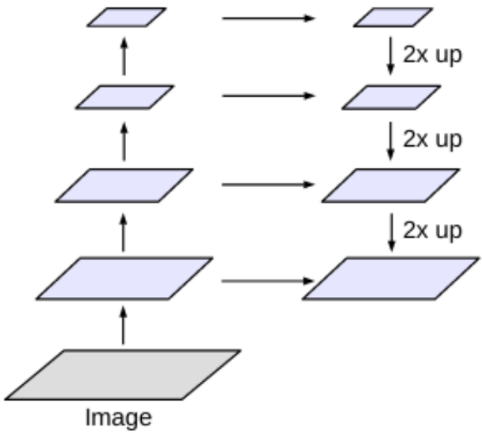
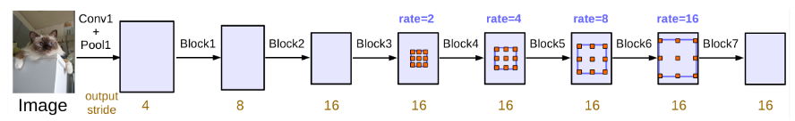
CNN model
DeepLabV3 ResNet50
First introduced by Chen et al in 2017
Encoder-Decoder.
Atrous Convolution.
Spatial Pyramid pooling.
Total Parameters = 39638869
Mean IOU(coco):66.4

Slide 7
DeepLabV3 ResNet50
Experimentation ( train test split : 80,20).
Hyperparameters:
Image resize : (1024,1024), (512,512)
Batch size = 4, 8, 16
Number of epochs = 1, 10, 16, 100
Learning rate = 0.001, 0.0001
Loss at the end of 100 epochs(best loss) = 0.0499
Best Hyperparameters :
Batch size = 16
Learning rate = 0.001
Num epochs = 100
Num classes = 8

Slide 8
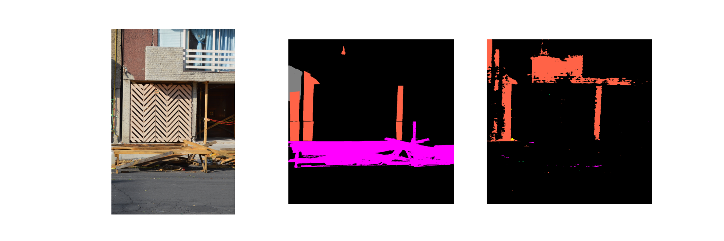
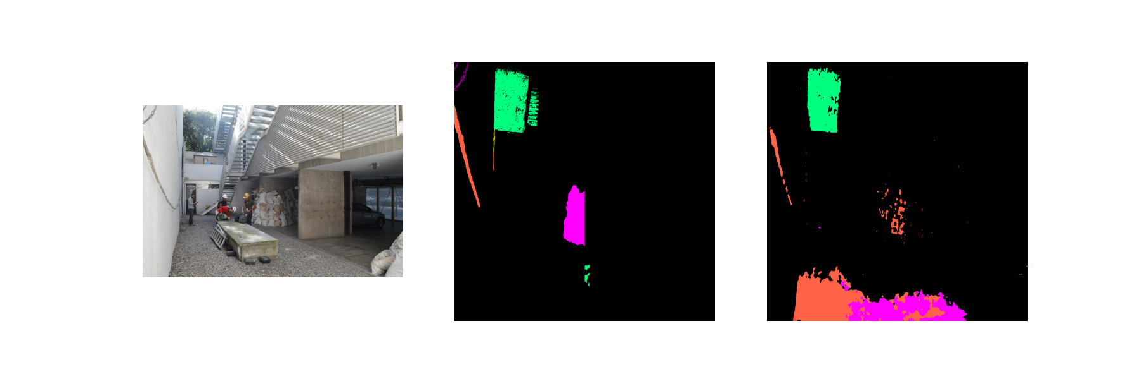
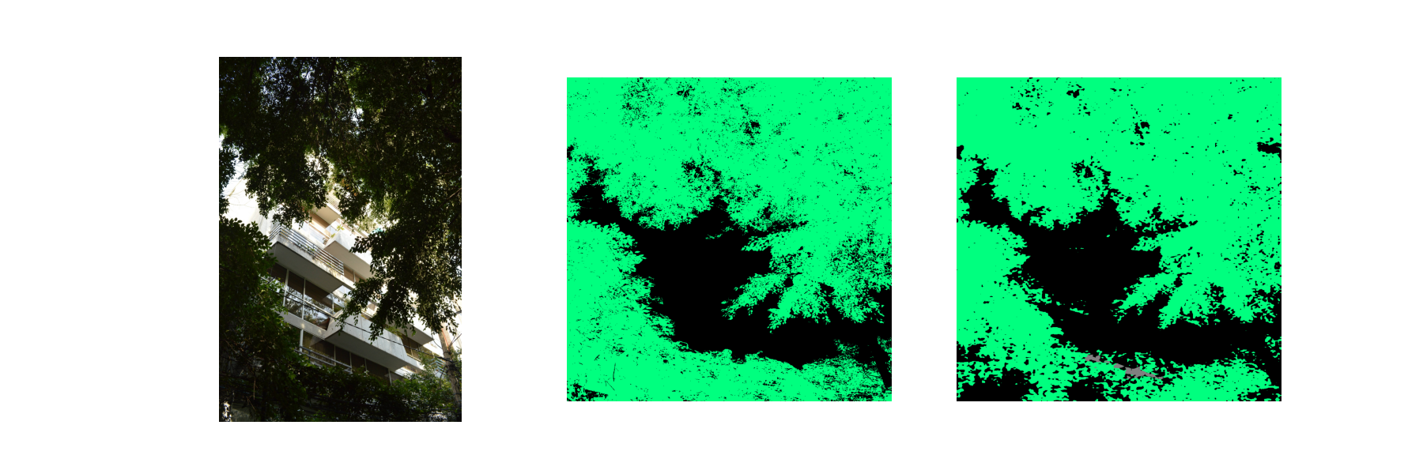
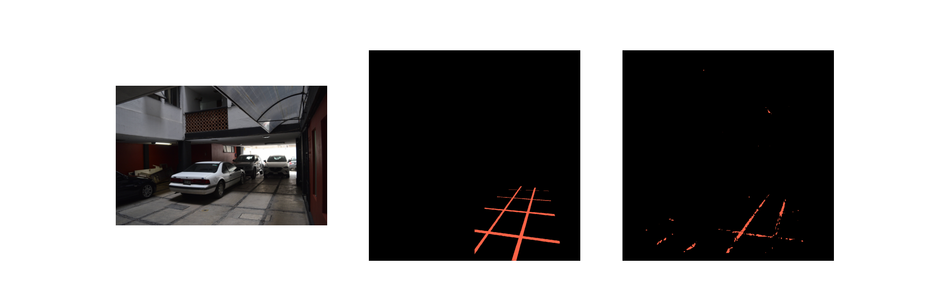
Image - Ground truth mask- Predicted mask (Coarse damage)

Slide 9
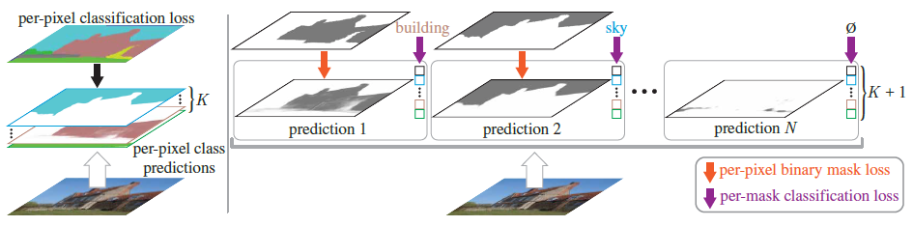
Transformer model
MaskFormer
Was proposed in Per-Pixel Classification is Not All You Need for Semantic Segmentation by Bowen Cheng, Alexander G. Schwing, Alexander Kirillov in 2021
52.7 PQ on COCO
55.6 mIoU on ADE20K
Per-pixel classification vs. mask classification.
(left) Semantic segmentation with perpixel classification applies the same classification loss to each location.
(right) Mask classification predicts a set of binary masks and assigns a single class to each mask.

Slide 10
Results - MaskFormer
Errors during training:
image_processor = AutoImageProcessor.from_pretrained("facebook/maskformer-swin-base-ade")
model = MaskFormerForInstanceSegmentation.from_pretrained("facebook/maskformer-swin-base-ade”)
predicted_semantic_map = image_processor.post_process_semantic_segmentation( outputs, target_sizes=[image.size[::-1]])[0]

Slide 11
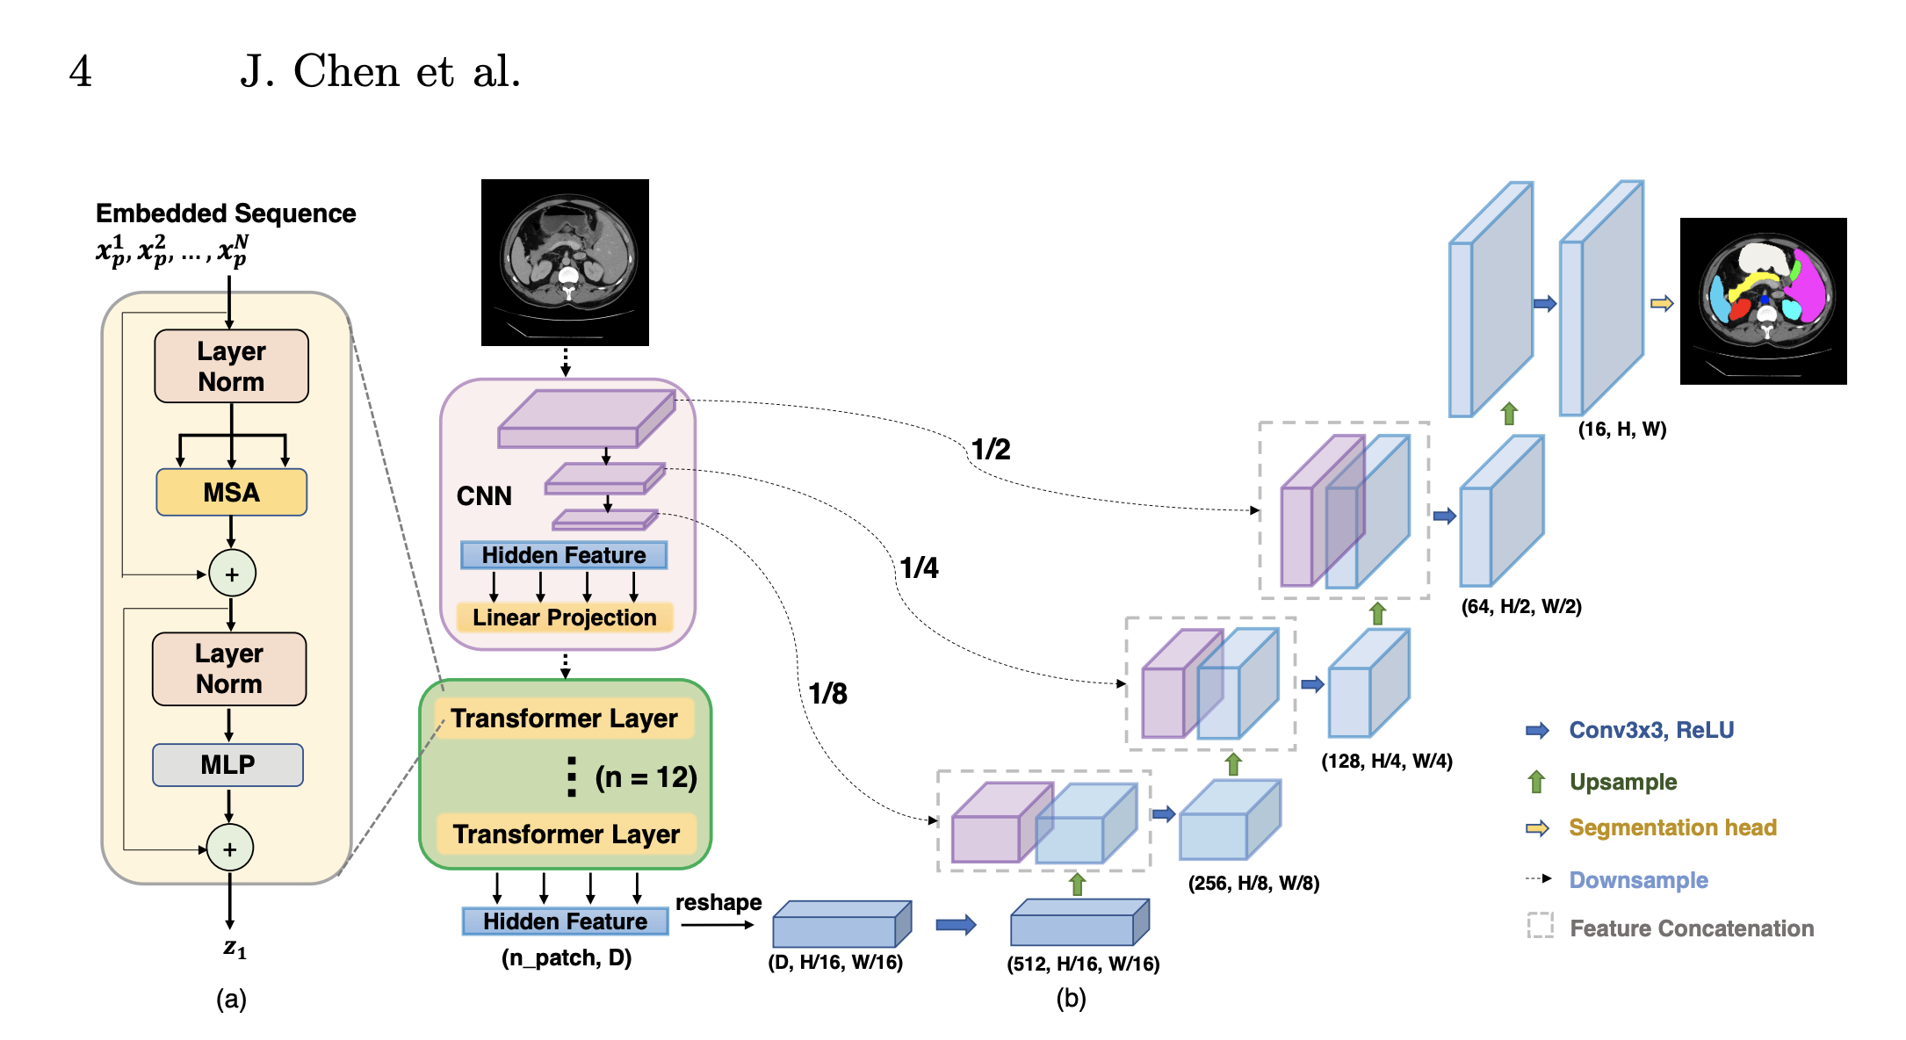
Transformer model
UNeTFormer
UNetFormer: A UNet-like transformer for efficient semantic segmentation of remote sensing urban scene imagery L Wang et al., 2022.
U-Net like Transformer with a CNN-based encoder and a Transformer based decoder
CNN → Hierarchical Feature Representation → Local Property of convolutions
TransUNet: Transformers Make Strong Encoders for Medical Image Segmentation
Model/parameters | U_Net | UNETFormer
total trainable parameters | 34,527,041 | 36,171,242

Slide 12
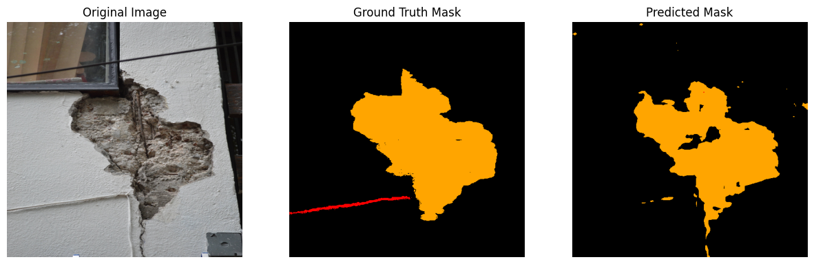
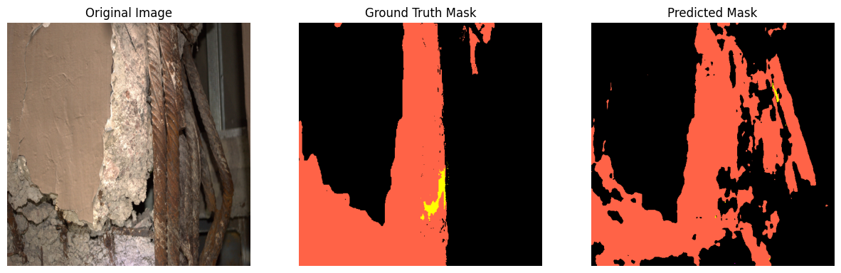
UNeTFormer
trial | Decoder dimensions | epochs | MIoU
1 | 64 | 100 | 0.45 (coarse)
2 | 128 | 20 | 0.35 (fine)
The cracks/labels are quite complicated to detect.
Model generally considers the structures like pillars or roof as damages.
Tried the model in two different architectures.

Slide 13
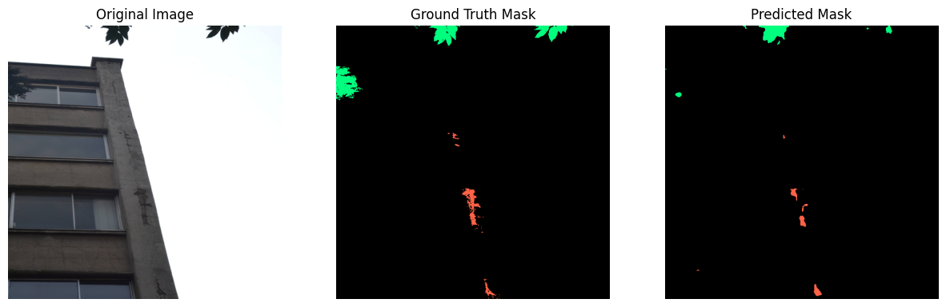
UNetFormer - CoarseDamage

Slide 14
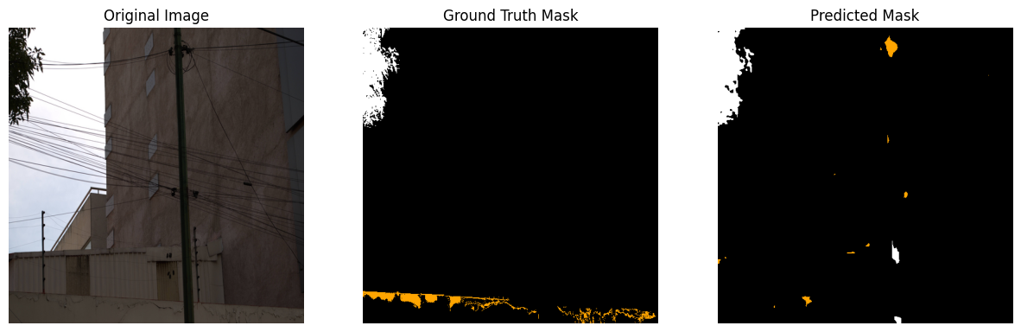
UNetFormer - CoarseDamage

Slide 15
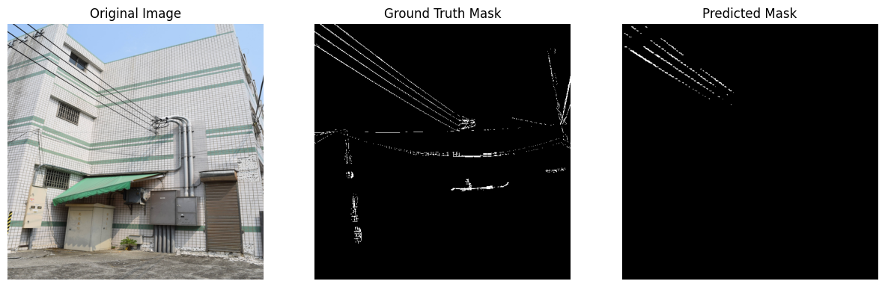
UNetFormer - FineDamage

Slide 16
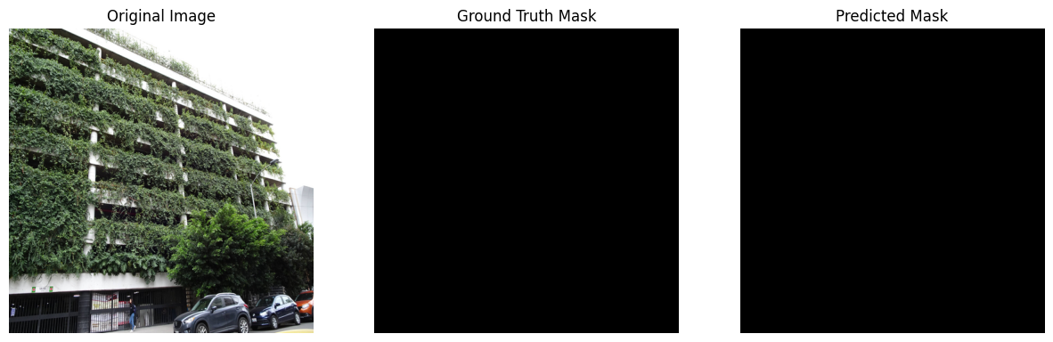
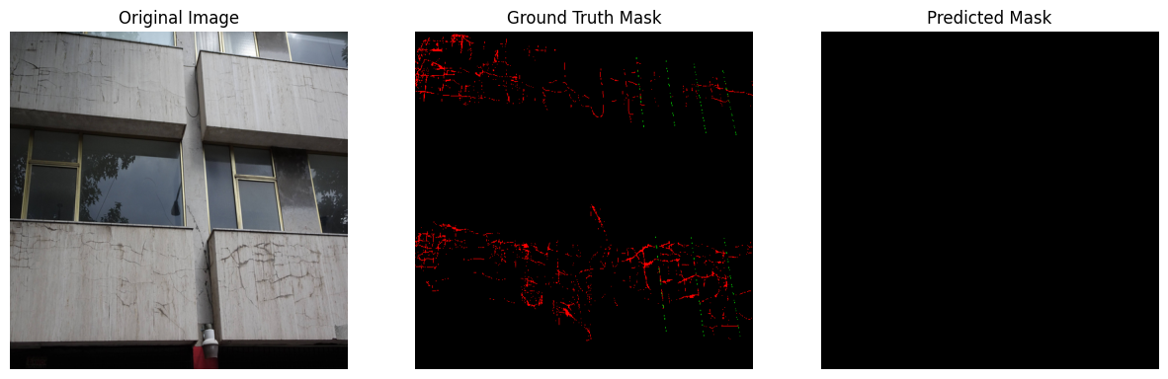
UNetFormer - FineDamage

Slide 17
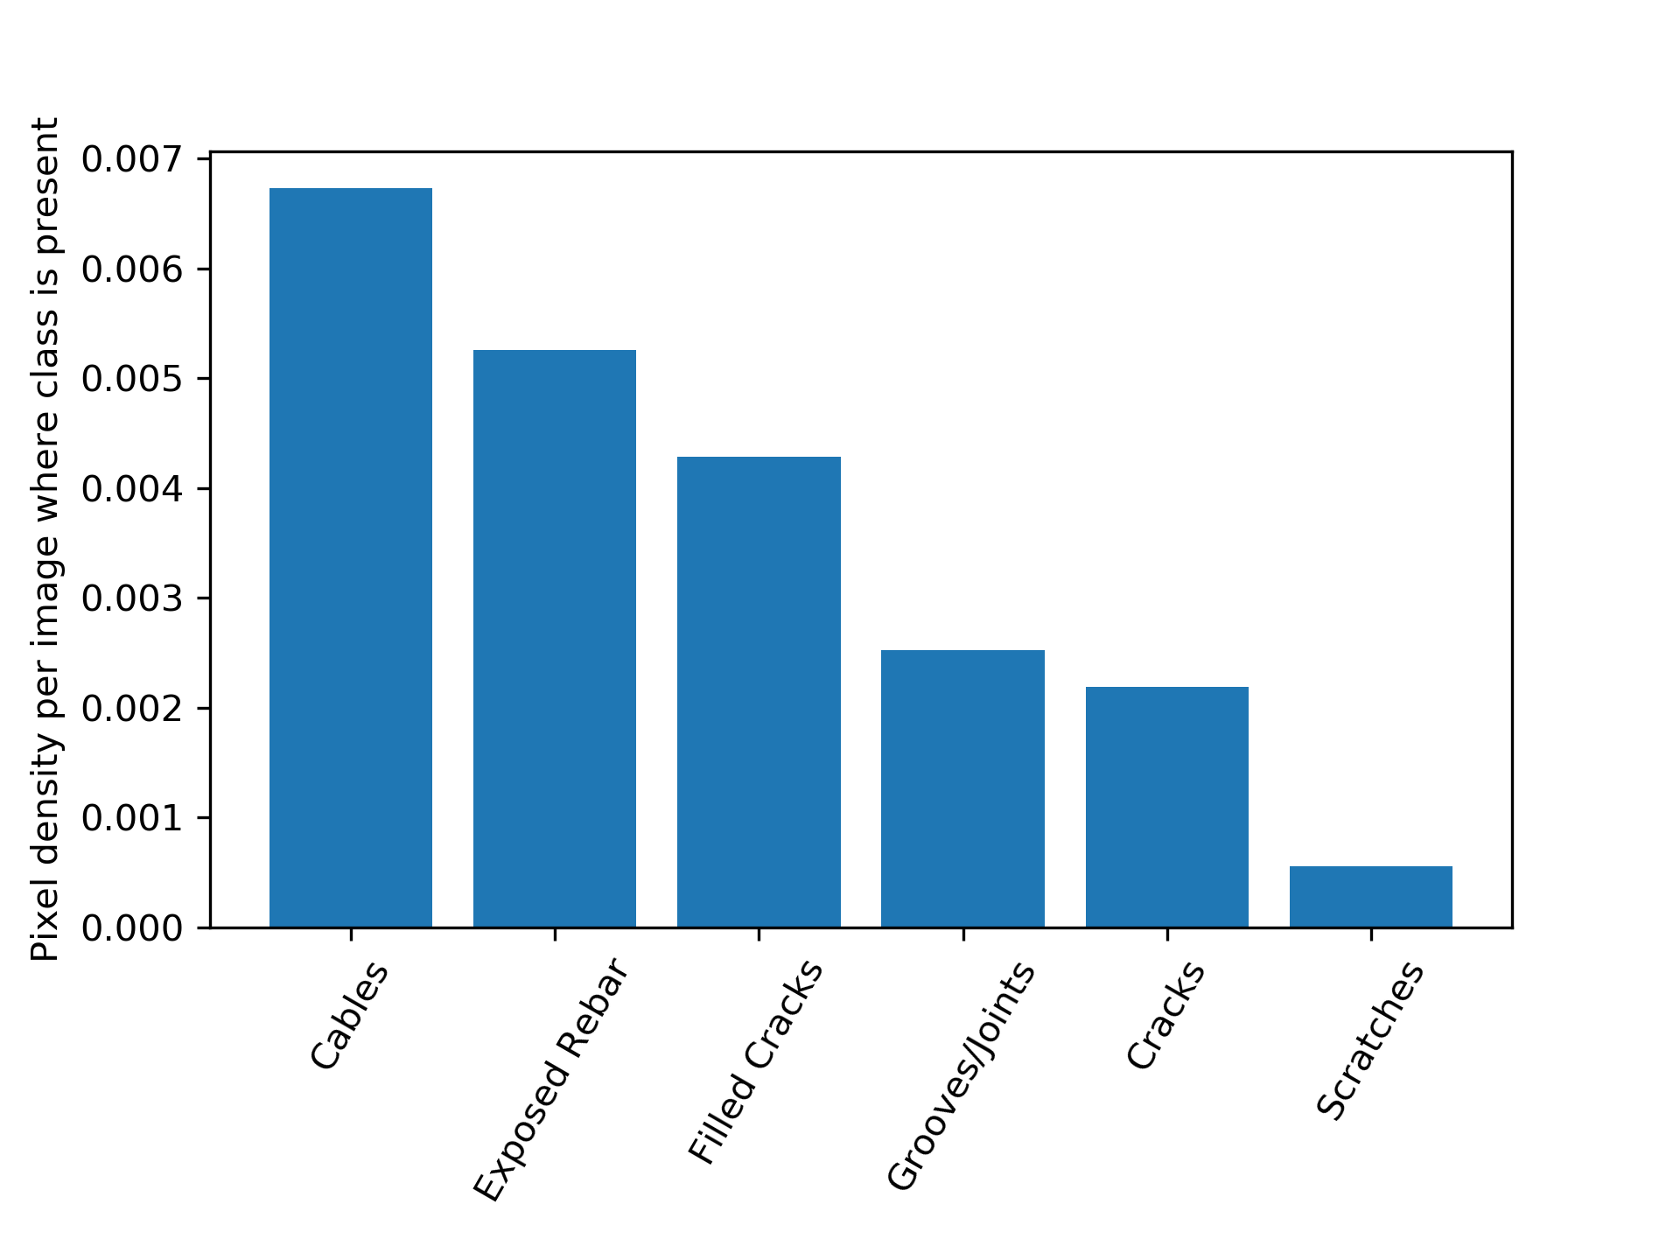
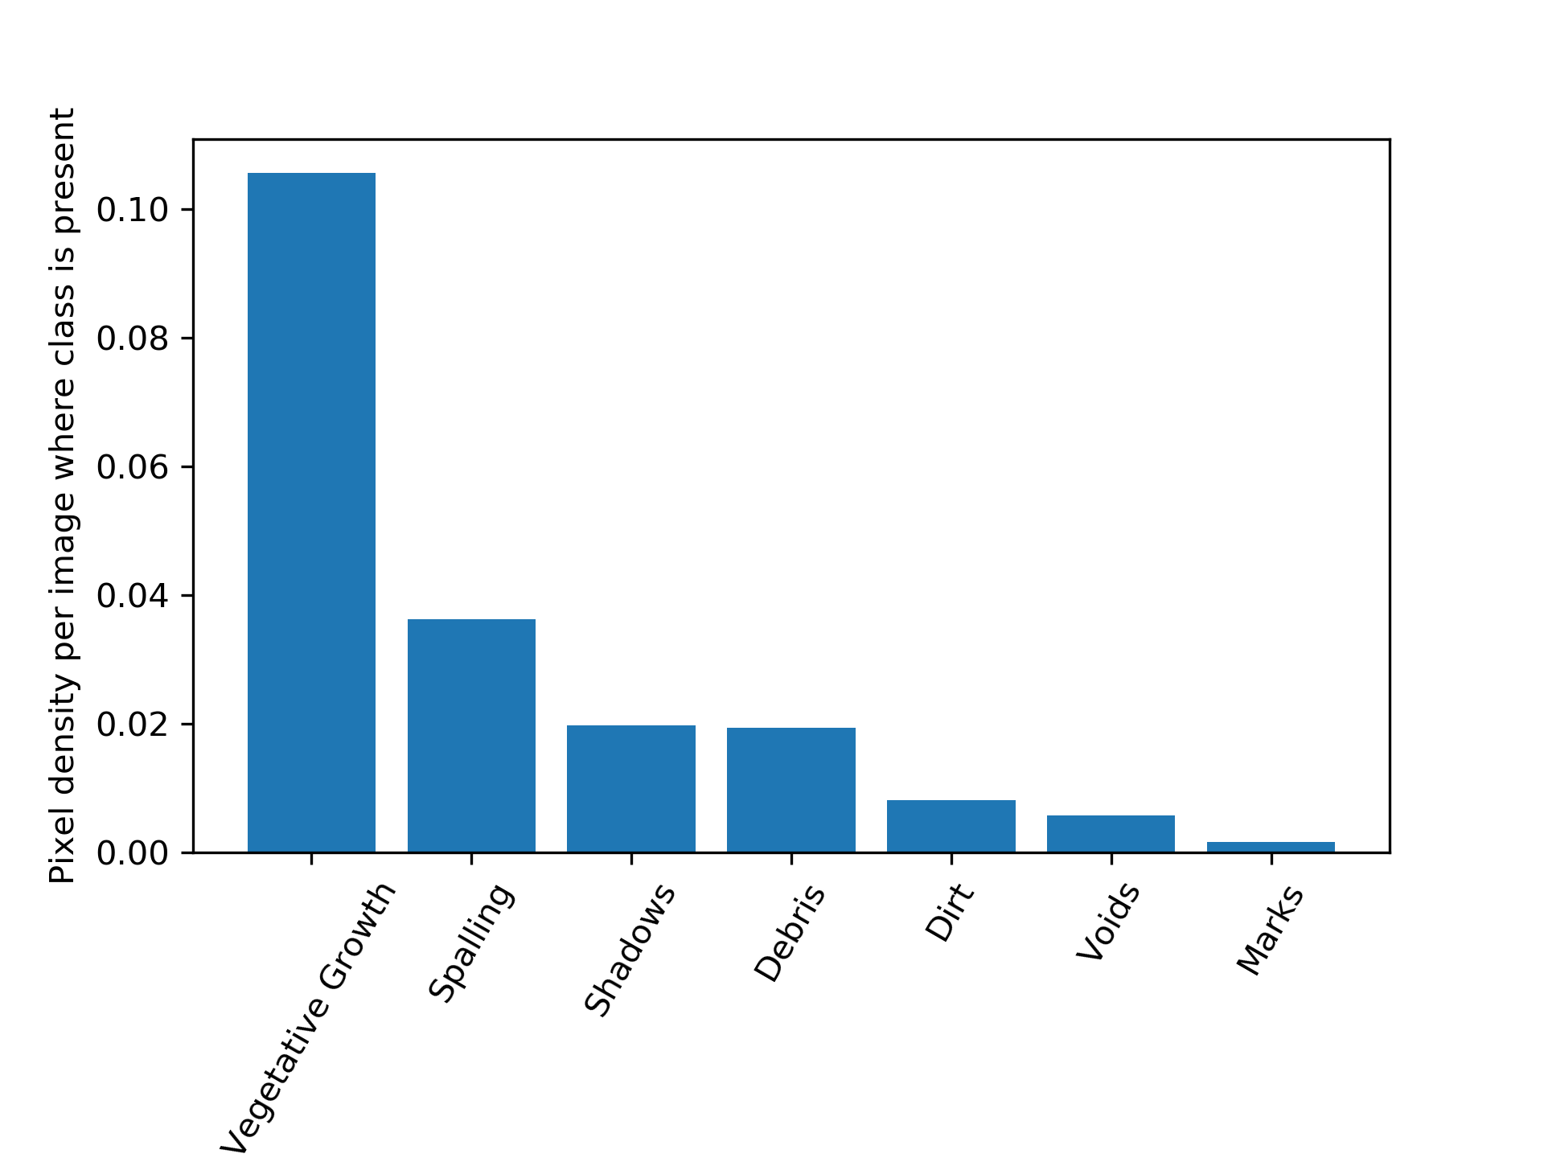
Conclusion and Future Scope
The data labels are imbalanced
Produced good results for coarse damage semantic segmentation using deeplabv3 semantic segmentation model and Transformers
Unsuccessful attempt to get the transformer models working on the Linux environment. (DiNAT, SwinTransformer, OnePeace, Segformer)
Very limited research in the field of fine damage segmentation made it hard to pick better performing models.
Majority of the best performing general models needed Linux environment, and further large sizes of these models has not allowed much exploration.
For further implementations, better training implementations could be followed. Explore larger models without memory issues and oversampling the low-class images.

Slide 18
THANK YOU

